Slide 1

Introduction Recommendation Systems and its Applications
By: Ved Bharti ved.bharti@freighthub.com

Slide 2
Agenda
Introduction
Recommendation Methods
Business and Statistical Evaluation Metric
Association rule mining
Case study
Best Practices

Slide 3
Introduction
Recommendation Engine
Information Filtering Systems
Deals with Problem of information overload
According to the users preferences, interest
Predict if User prefer an item or not based on the Users Profile
Objectives
Increase Sale
Knowing user’s need, personalized recommendations
Increase number of registered users
Better User Time management
Making more option available to user

Slide 4
How does Recommender System helps?
Promote users item discovery.
Very less number of items accumulate most sale or positive ratings
Serendipity – identify items from the Long Tail Users did not know about existence
Ref.: https://blog.johnrchildress.com/2015/05/13/culture-change-and-the-long-tail/

Slide 5
Recommendation System
Recommendation Content (Product, Movies, articles etc.)
User Data (User ratings, feedback, user profile) Explicit Profiling: Users are asked to fill some information regarding the likes and interest, Ratings Implicit Profiling: Tracking user’s activities on the portal, User purchased history, pages visited, and data obtained via cookies
Recommendation Techniques - Content based - Collaborative filtering - Demographic - Utility based - Hybrid

Slide 6
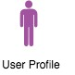

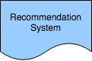
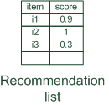

Methods recommender systems
Content Based
Collaborative Filtering
Hybrid
Personalized recommendations

Slide 7
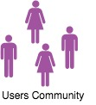

Methods of recommender systems
Collaborative: ”Finds what's popular among users with similar preferences"
Drawbacks: Data Sparsity – Cold Start, Scalability, Gray Sheep and Synonyms
Notes:
Scalability: numbers of users and items grows, computations needs very large memory machines
Gray Sheep: users whose opinions do not consistently agree or disagree with any group of people
Synonyms: very similar items to have different names or entries

Slide 8
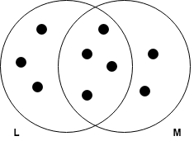
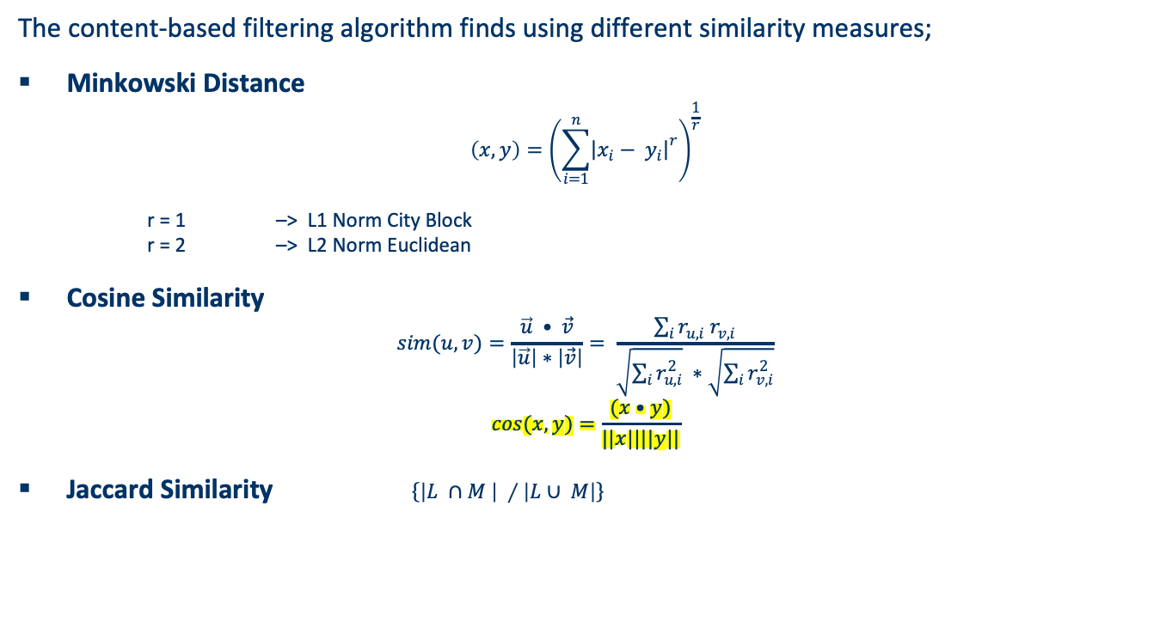
Similarity Measures
The content-based filtering algorithm finds using different similarity measures;
Minkowski Distance $\left(x,y\right)={\left(\sum_{i=1}^{n}{{\left|\left.x_{i}− y_{i}\right|\right.}^{r}}\right)}^{\frac{1}{r}}$
r = 1 –> L1 Norm City Block r = 2 –> L2 Norm Euclidean
Cosine Similarity $sim(u,v)=\frac{\vec{u} • \vec{v}}{\left|\vec{u}\right|∗\left|\vec{v}\right|}= \frac{\sum_{i}{r_{u, i} r_{v, i}}}{\sqrt{\sum_{i}{r_{u,i}^{2}}} ∗\sqrt{\sum_{i}{r_{v,i}^{2}}}}$
$$cos(x,y)=\frac{(x•y)}{||x||||y||}$$
Jaccard Similarity $\left\{\left.\left|L ∩M \right| ∕\left|L∪ M\right|\right\}\right.$

Slide 9
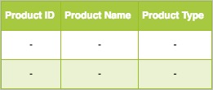

Methods of recommender systems
Content-based: ”Finds similar products what user have liked"
Item Profile
Drawbacks: It is limited to recommending items that are of the same type. It will never recommend products which the user has not bought or liked in the past.

Slide 10
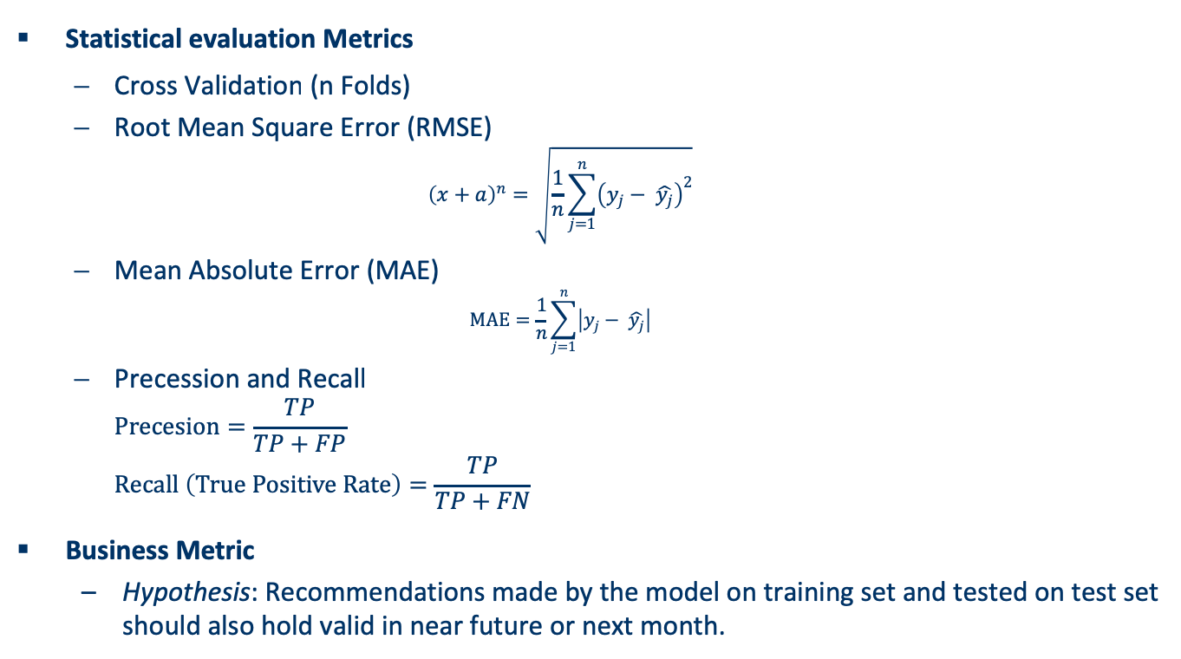
Business and Statistical Evaluation Metric
Statistical evaluation Metrics
Cross Validation (n Folds)
Root Mean Square Error (RMSE) ${\left(x+a\right)}^{n}=\sqrt{\frac{1}{n}\sum_{j=1}^{n}{{\left(y_{j}− \hat{y_{j}}\right)}^{2}}}$
Mean Absolute Error (MAE) $MAE=\frac{1}{n}\sum_{j=1}^{n}{\left|y_{j}− \hat{y_{j}}\right|}$
Precession and Recall $Precesion=\frac{TP}{TP+FP}$ $Recall \left(True Positive Rate\right)=\frac{TP}{TP+FN}$
Business Metric
Hypothesis: Recommendations made by the model on training set and tested on test set should also hold valid in near future or next month.
 | Recommended | Not Recommended
Purchased/ Used | True Positive (TP) | False Negative (FN)
Not Purchased / Unused | False Positive (FP) | True Negative (TN)
Notes:
RMSE: standard deviation of difference among predicted rating to the true rating. The difference is also known as residuals.
MAE: average absolute difference of predicted rating and true rating value.

Slide 11
Association Rule Mining
Apriori algorithm
Does not require Ratings
Unsupervised learning
Transformed data to transactions
Pruning the rules
If super rule possesses same lift or less support, then super rule (with more items) can be dropped)
Ref.: https://www.saedsayad.com/association_rules.htm

Slide 12
Best Practices
Understand the user item interactions from the data
Evaluate the rating, if missing compute the ways to generate the ratings
Train/Test set selection in order to obtain maximum details of both products and customers
Model selection and tuning the parameters based on the respective model
Always assess model using both statistical measures and business metric

